Slide 1
Hospital Management System
User Interface Presentation Presented by : Group 5
Student ID:1005011
1005016
1005019
1005021
1005024

Slide 2
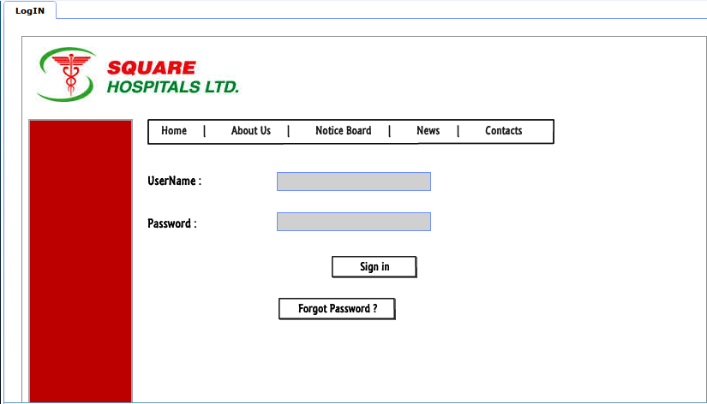
LOGIN

Slide 3
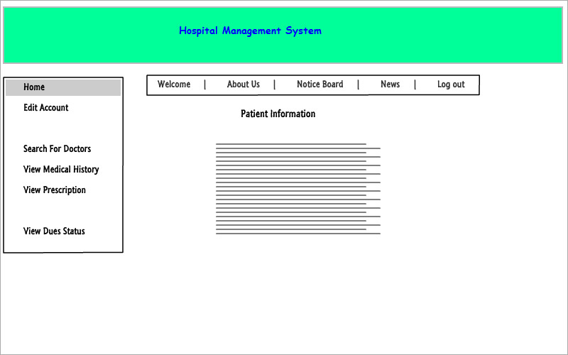
PATIENT HOME

Slide 4
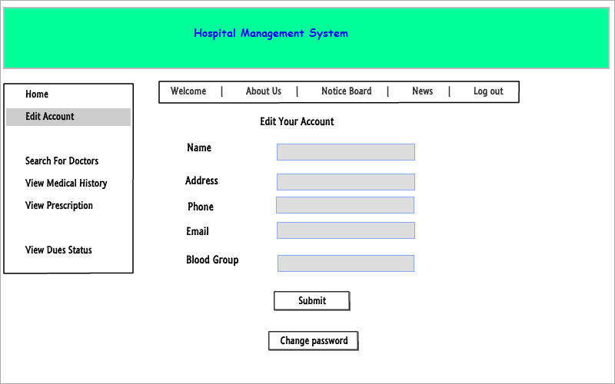
PATIENT CONTACT EDIT

Slide 5
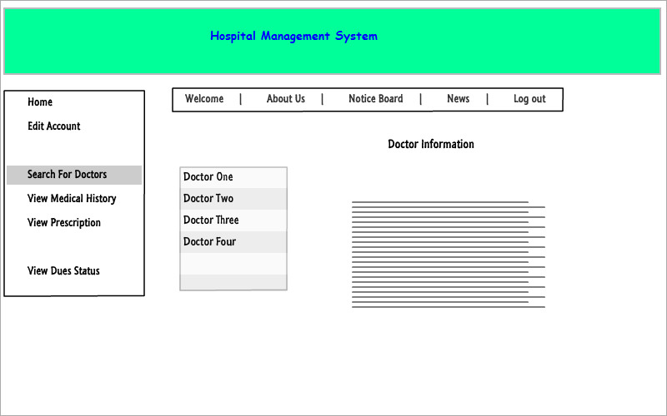
PATIENT SEARCH FOR DOCTORS

Slide 6
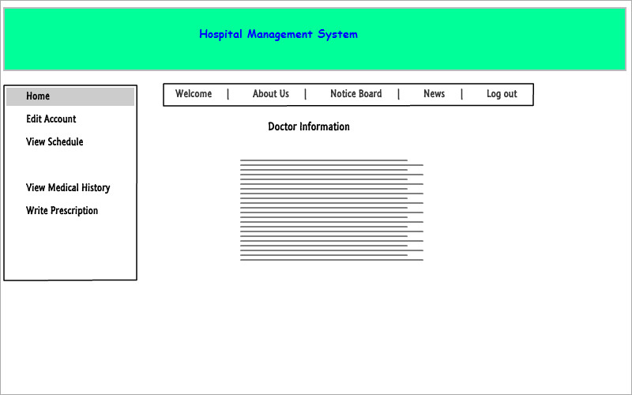
DOCTOR HOME

Slide 7
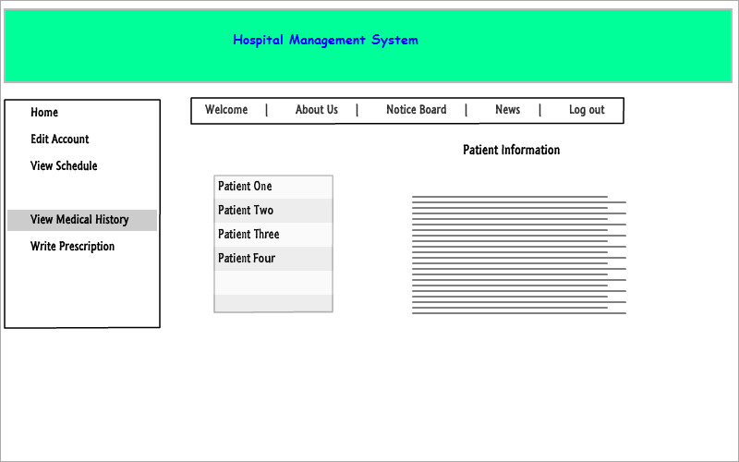
DOCTOR PATIENT HISTORY

Slide 8
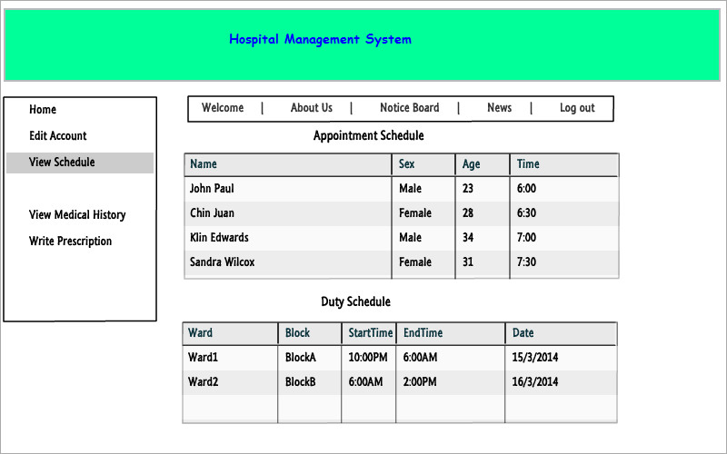
DOCTOR VIEW SCHEDULE

Slide 9
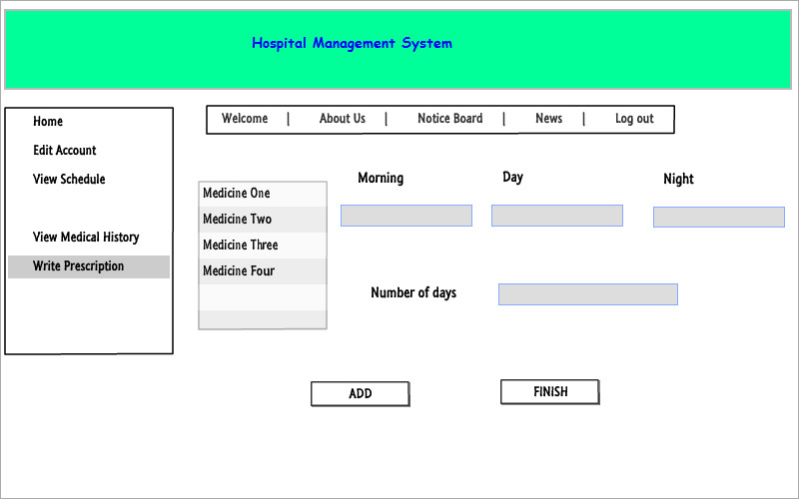
PREPARE PRESCRIPTION

Slide 10
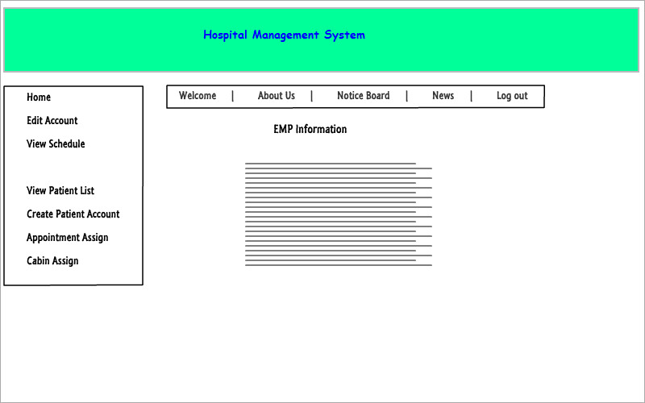
RCP HOME

Slide 11
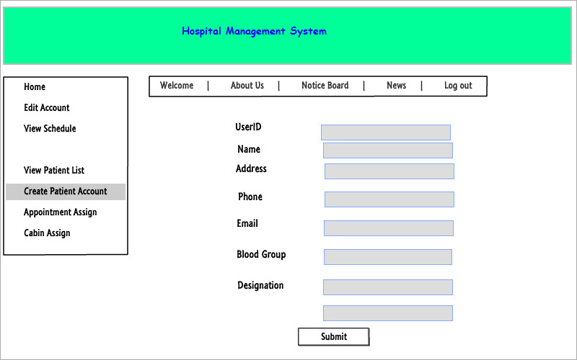
CREATE PATIENT ACCOUNT

Slide 12
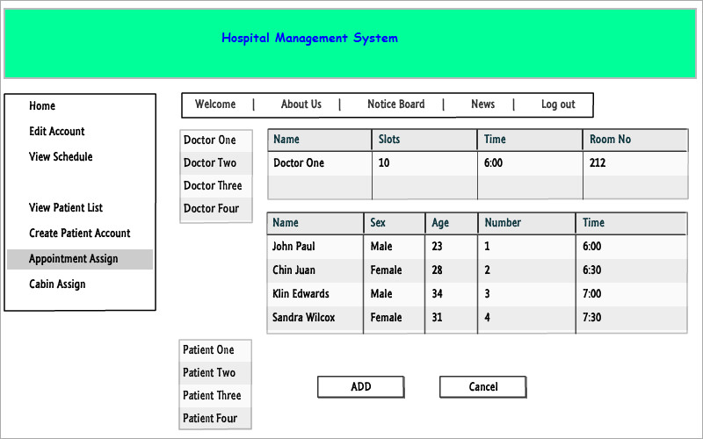
ASSIGN DOCTOR

Slide 13
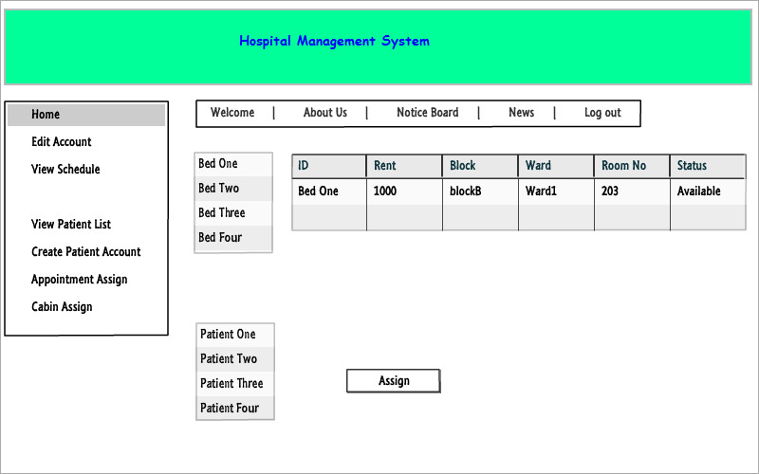
CABIN ASSIGN

Slide 14
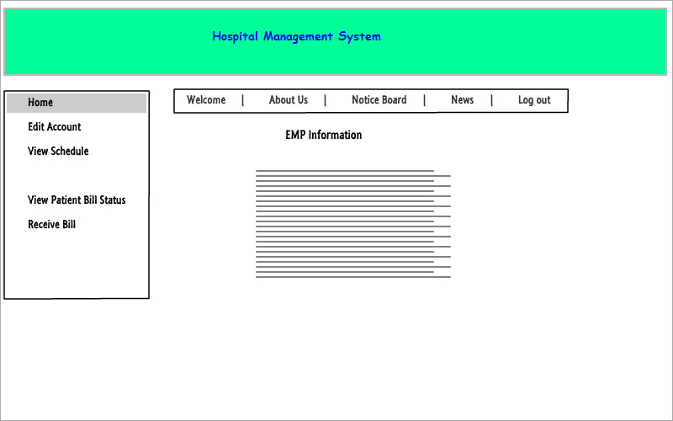
CLERK AS EMPLOYEE HOME

Slide 15
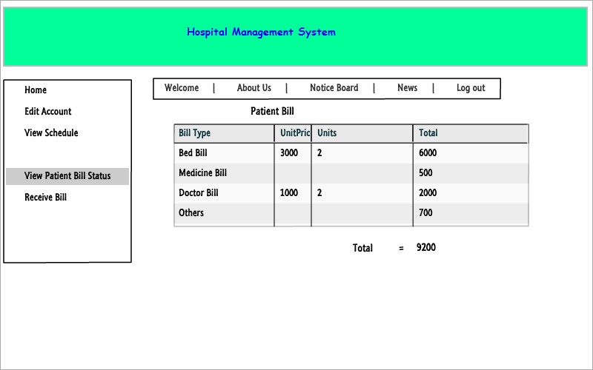
PATIENT/CLERK VIEW BILL STATUS

Slide 16
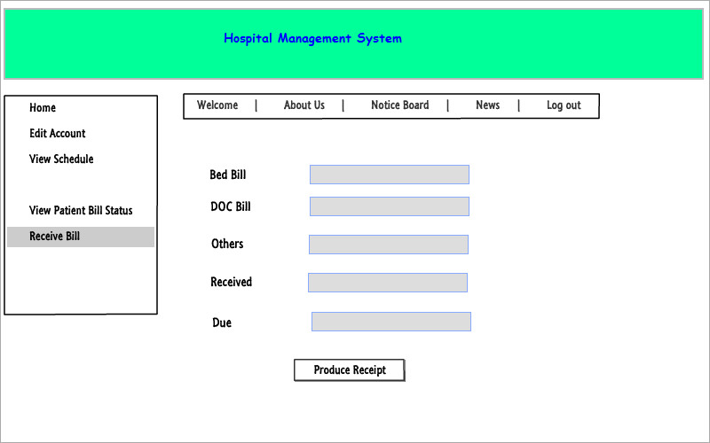
CLERK BILL RECEIVE

Slide 17
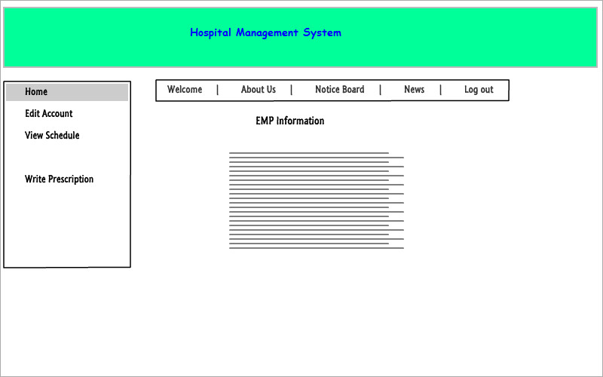
DEM AS EMPLOYEE HOME

Slide 18
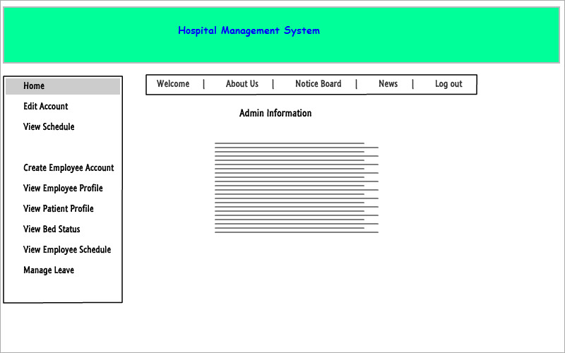
ADMIN HOME

Slide 19
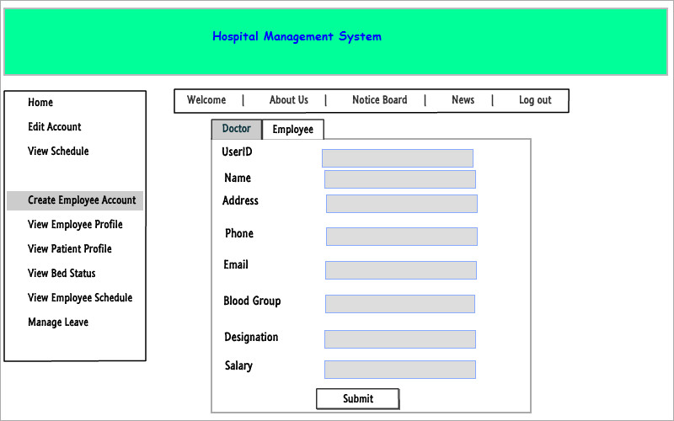
ADMIN EMPLOYEE PROFILE CREATION

Slide 20
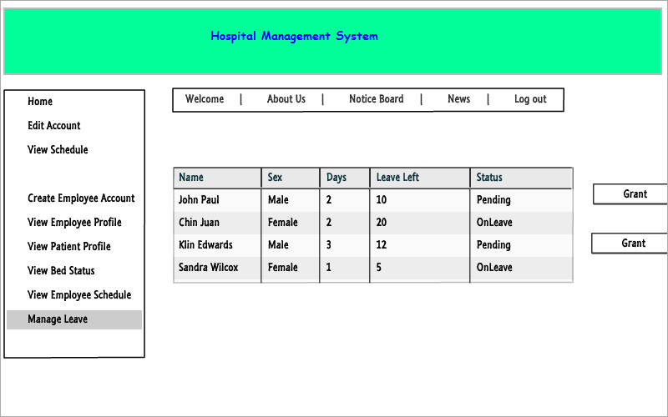
ADMIN LEAVE MANAGEMENT

Slide 21
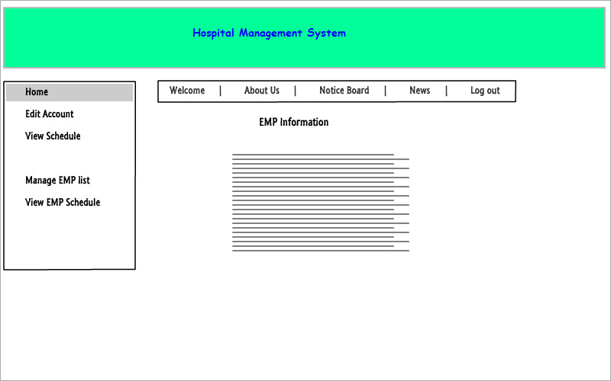
HRO HOME

Slide 22
THANK YOU
QUESTIONS?

